Slide 1
Storage of other¹ files
1. Mapping, grouping, config, etc

Slide 2


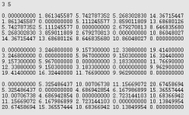

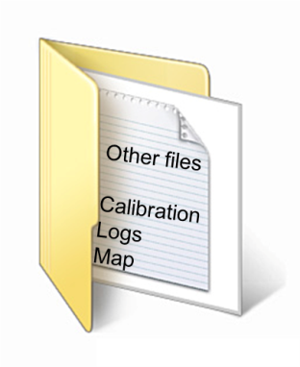
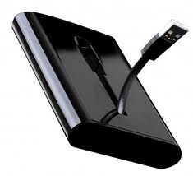


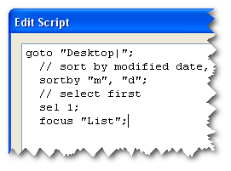

What the user needs
Data
Notes:
require all their data on a local machine.
downloading large datasets across the Janet network is very time consuming.
calibration data and log files and map files.
reduction scripts and other bits and bobs.
need to remember how to use the application.
Users are busy and have other things to do
This strategic vision for the project is to produce a framework that maximises the time spent actually performing data analysis, and minimises the time setting the framework up. To present the user with a common and flexible framework that allows efficient and timely publication of ISIS data.

Slide 3
Where are the other files
Direct Inelastic: SVN repository
SANS: File System
Crystallography: File System
Muon: Nexus file

Slide 4
Meeting Aim
Agree if this is a problem that needs addressing
Agree on the best approach to tackle the problem, for the medium and long term at ISIS
Time permitting, build a list of high level requirements for a possible solution

Slide 5
What we need to consider
Impact on instrument scientists
Migration of existing scripts
Implementation resource
How this would be maintained

Slide 6
Possible options for a central location
Storing the files in icat alongside the data files
A shared central repository – using something like svn or git
Using the (yet to be released) mantid script library functionality
Merging the appropriate data into the “raw” data nexus files
Storing the Files in the ISIS data archive

Slide 7
Input from Pascal
Favourite option
whatever makes this as light as possible for the instrument scientists.
Possibly an automated use of icat.
Look for RB numbers (we still need a manual way of doing it) and associated runnos/logfiles on the instrument machine and get the processed data, etc... put V runs/empties in there (needs a way to flag up the correct ones to use) a folder it creates for that experiment.
In the short term
need a permanent link to something like icat from the analysis machine (I have to use dropbox at the moment) where instrument scientists can drop processed data in folders they can create.
if security is an issue, give permission to some email addresses/clrc account only and users can also do that but only to folders linked their usernames.

